Slide 1


The Lesser Known s
of the Tidyverse
Emily Robinson
@robinson_es

Slide 2
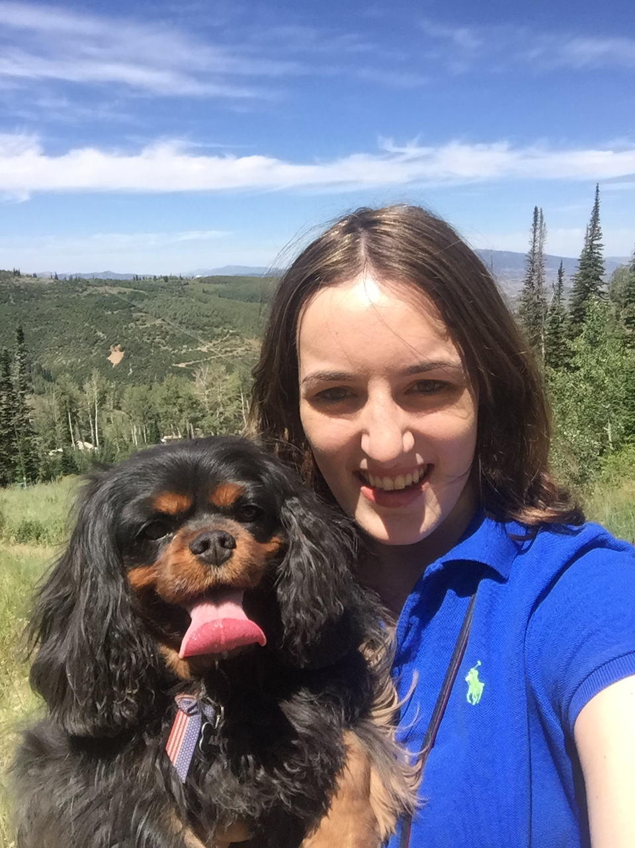
About Me
R User ~ 6 years
Data Scientist at DataCamp (as of 4 days ago)
Enjoy talking about:
A/B testing
Building and finding data science community
R

Slide 3

Talk Goals

Slide 4
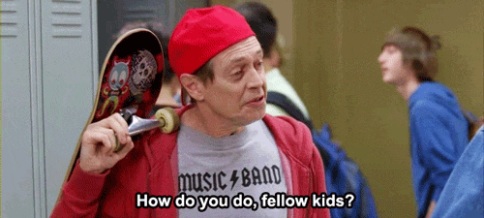
1. Keep you hip to the lingo

Slide 5

2. Stop you from doing this ….

Slide 6

…. by sharing useful functions

Slide 7
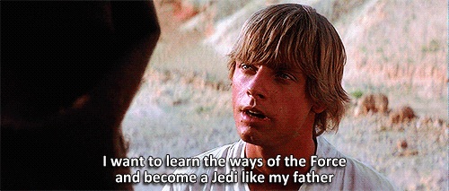
3. Point you to resources

Slide 8

The Tidyverse

Slide 9
Coherent system of packages for data manipulation, exploration, and visualization that share a common design philosophy

Slide 10
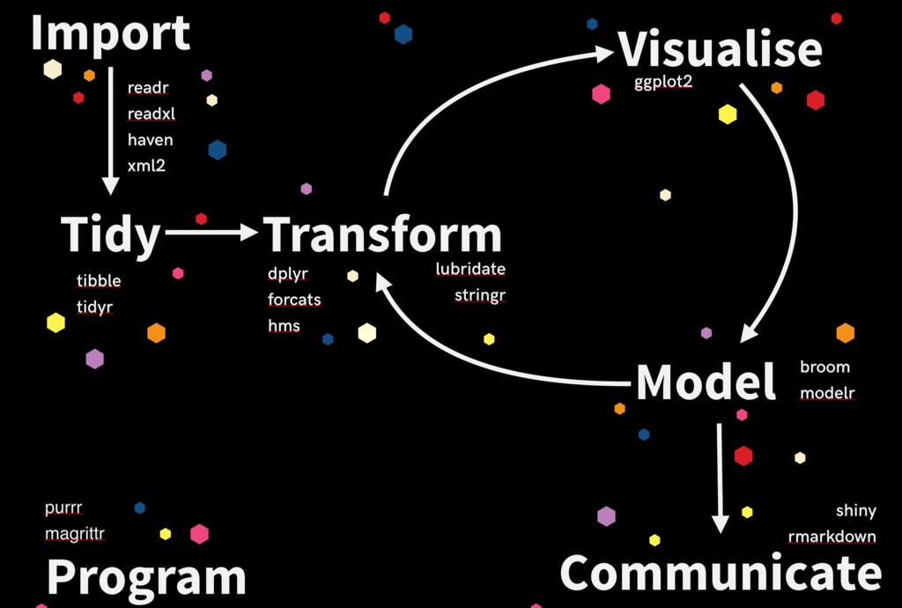

Slide 11
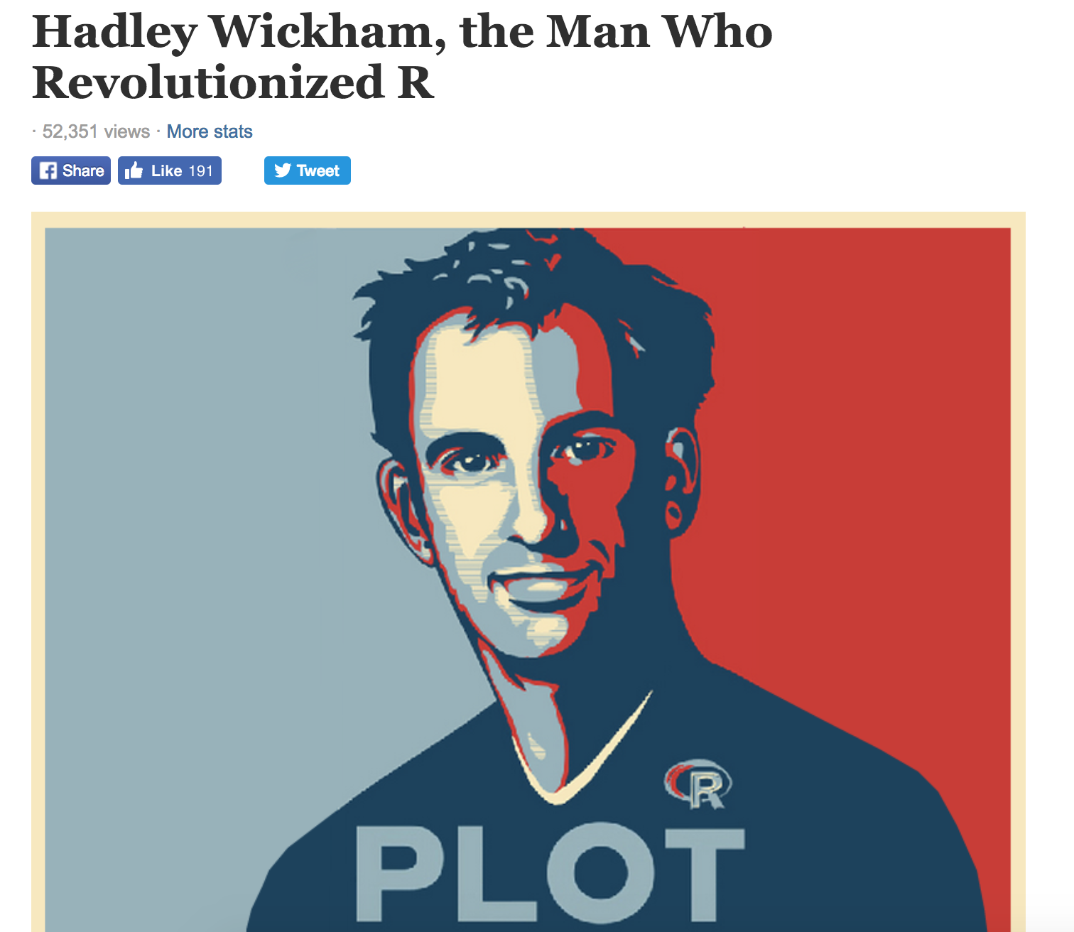

Slide 12

?
=
Tidyverse

Slide 13
!
=
Tidyverse

Slide 14







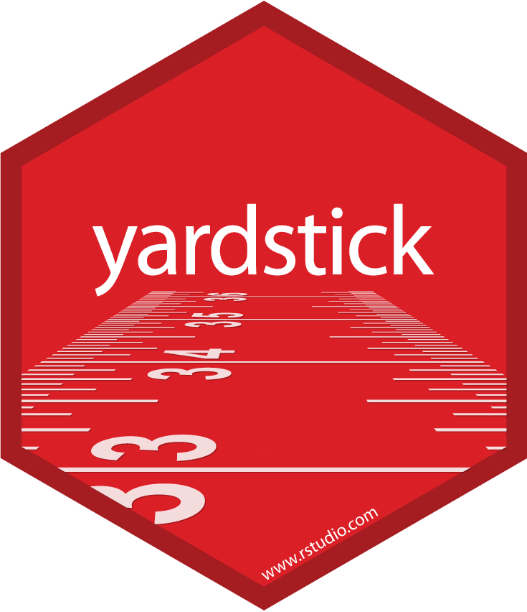



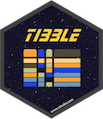
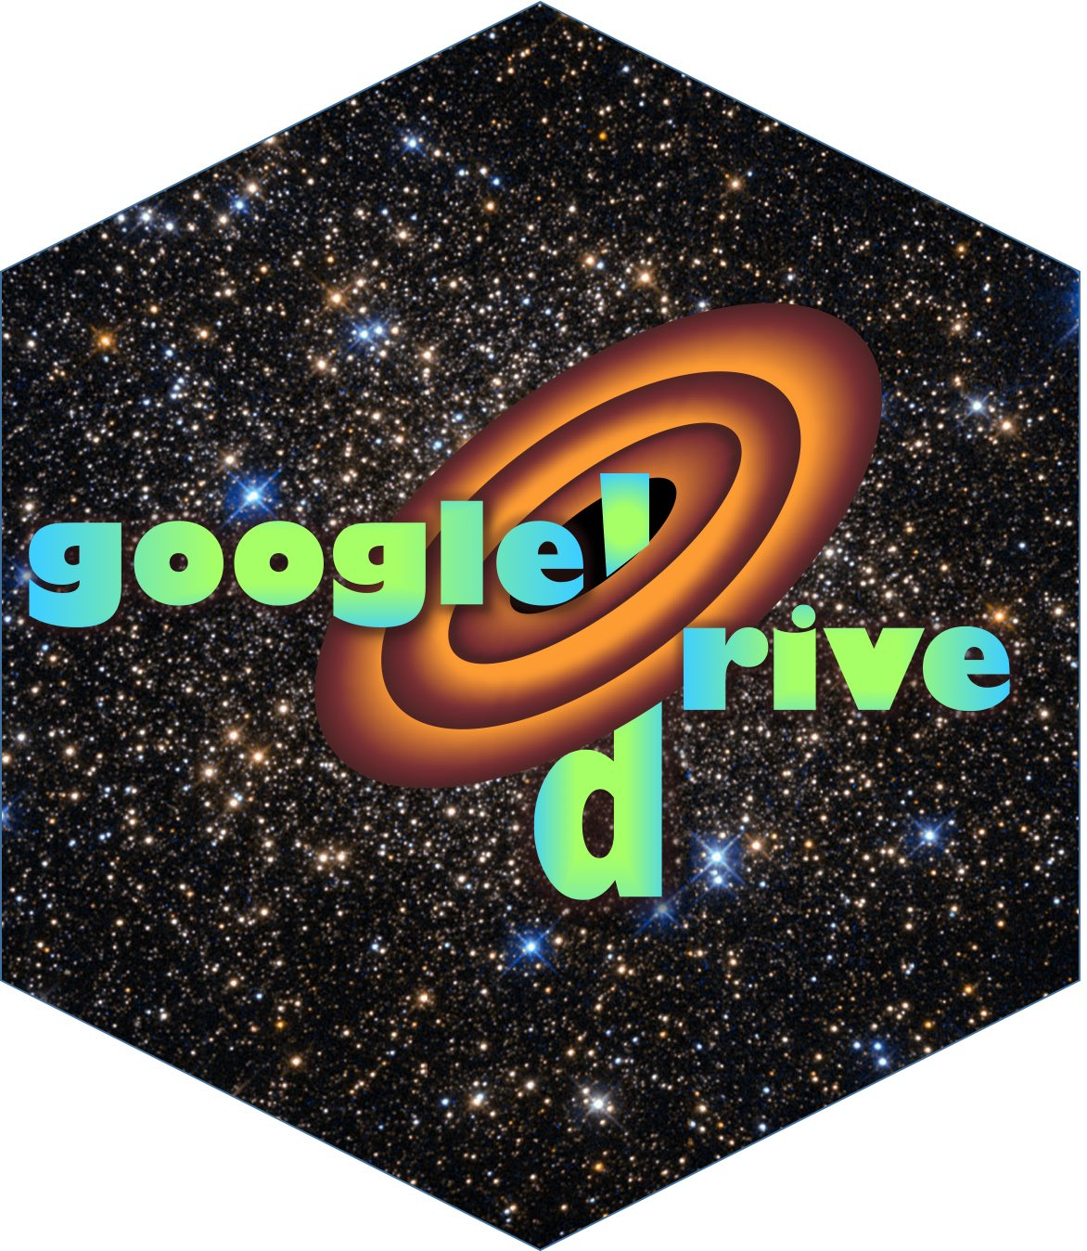
Tidyverse != Hadleyverse

Slide 15


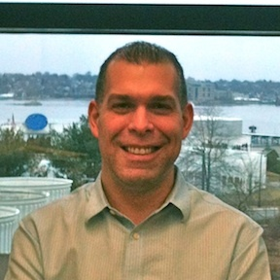

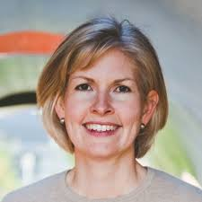
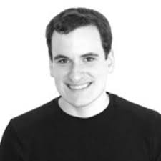
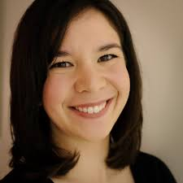


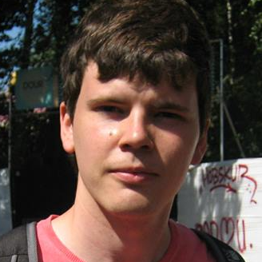
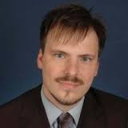
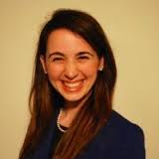
Tidyverse != Hadleyverse
Many other contributors

Slide 16

Demo

Slide 17
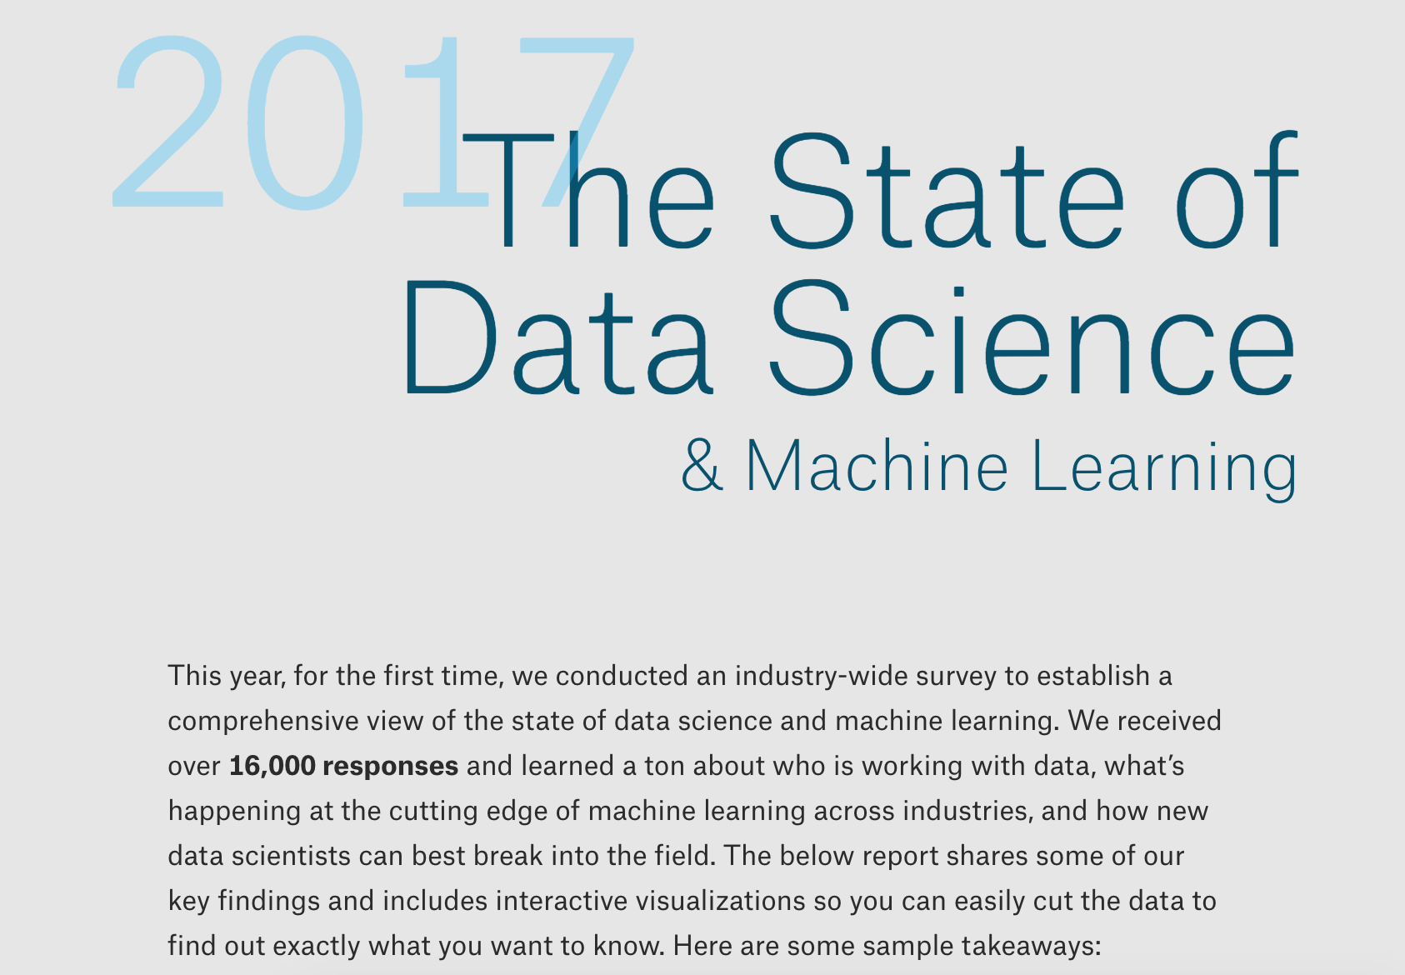

Slide 18
Review
Other
Dplyr
readr::read_csv
skimr::skim
%<>%
purrr:map_df
tidyr:gather
tidyr:unnest
stringr::str_split
forcats::fct_infreq
forcats::fct_relevel
Trelliscopejs::facet_trelliscope
ggthemr::ggthemr
ggthemes::theme_tufte
na_if
count
select_if
n_distinct
add_count

Slide 19
Resources

Slide 20
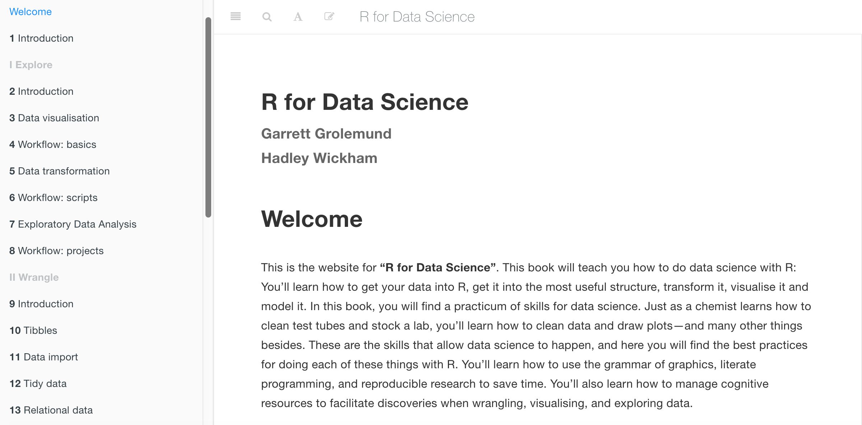
R4ds.had.co.nz

Slide 21
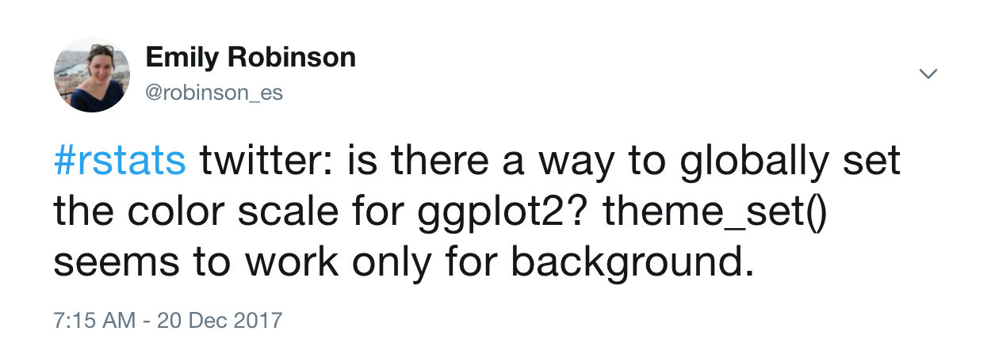
#rstats twitter

Slide 22
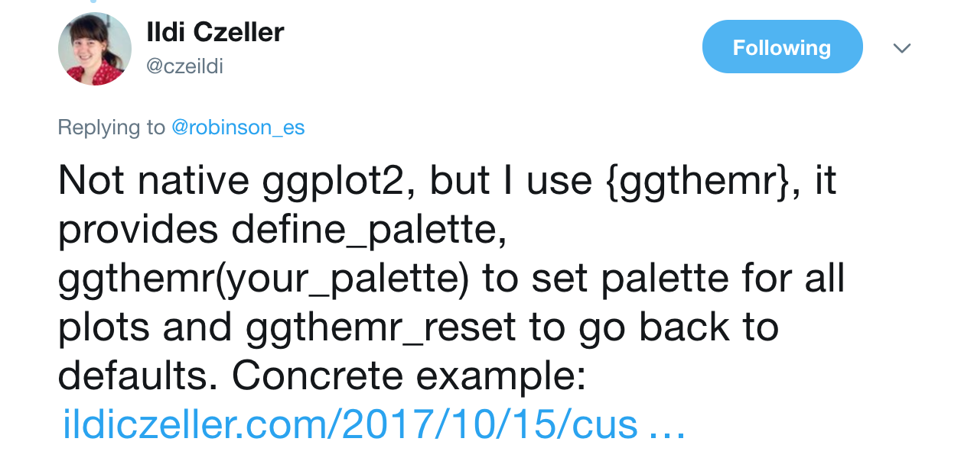
#rstats twitter

Slide 23
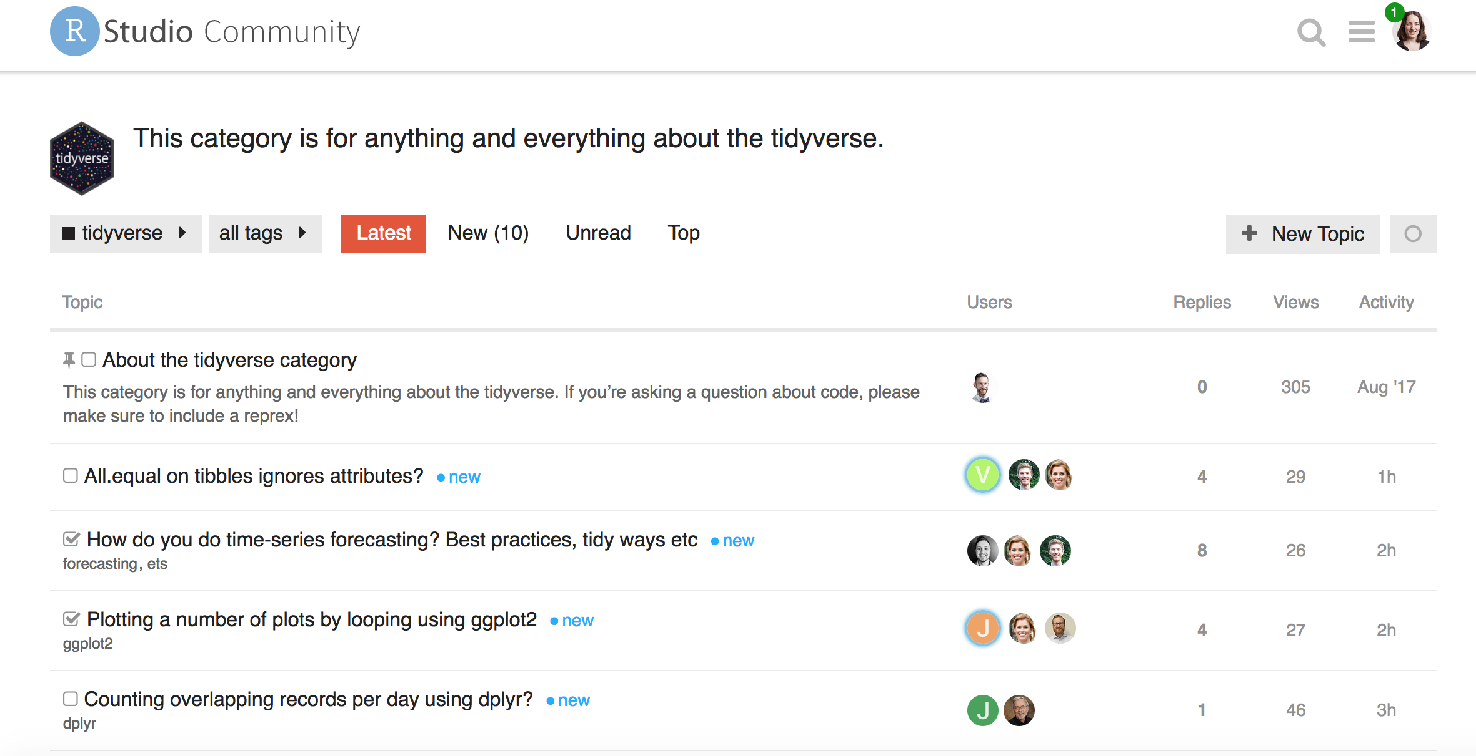
Community.rstudio.com/c/tidyverse

Slide 24
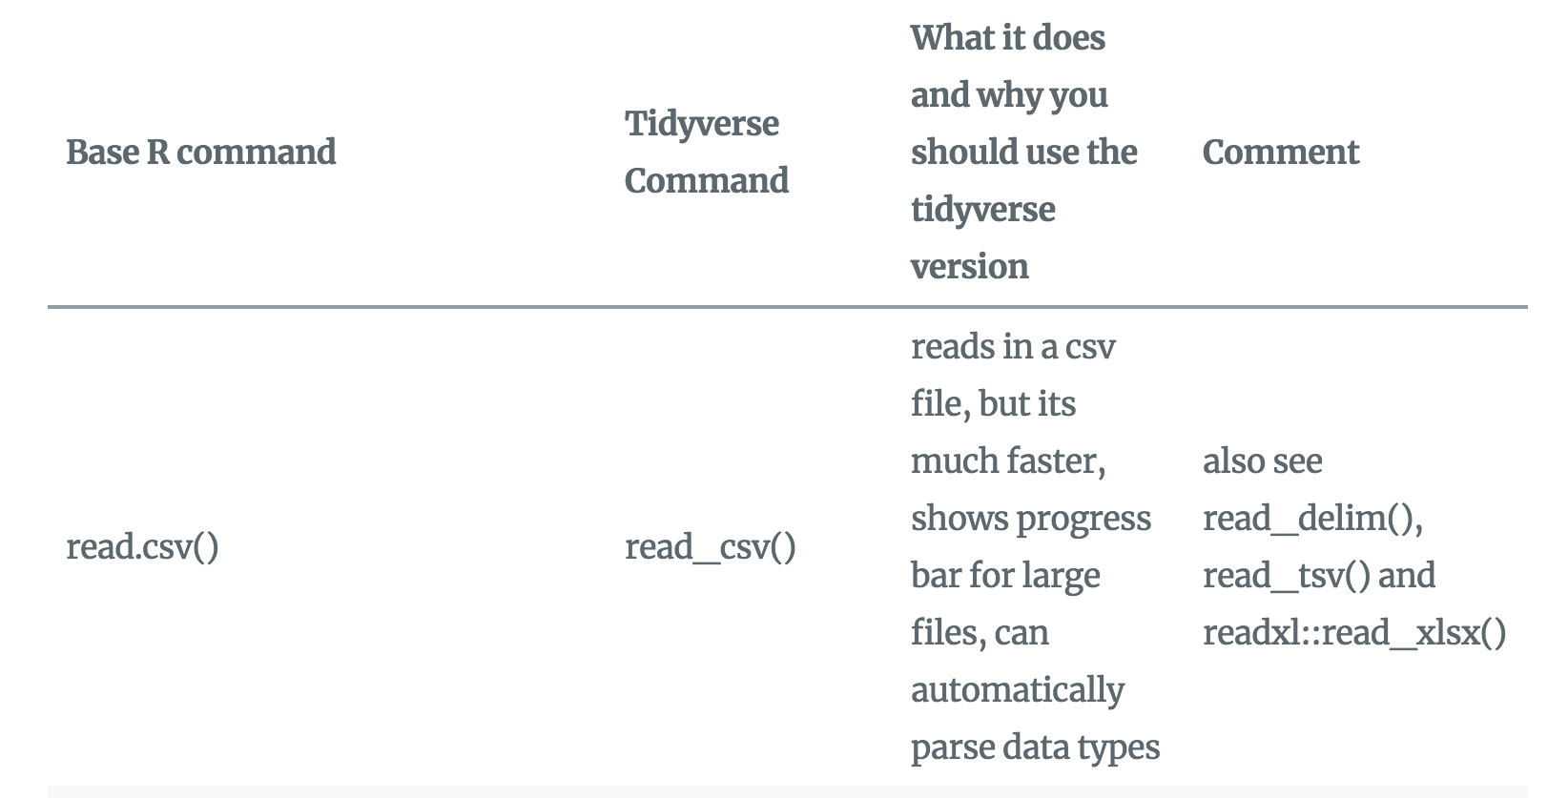
Base R to tidyverse translation
www.significantdigits.org/2017/10/switching-from-base-r-to-tidyverse

Slide 25
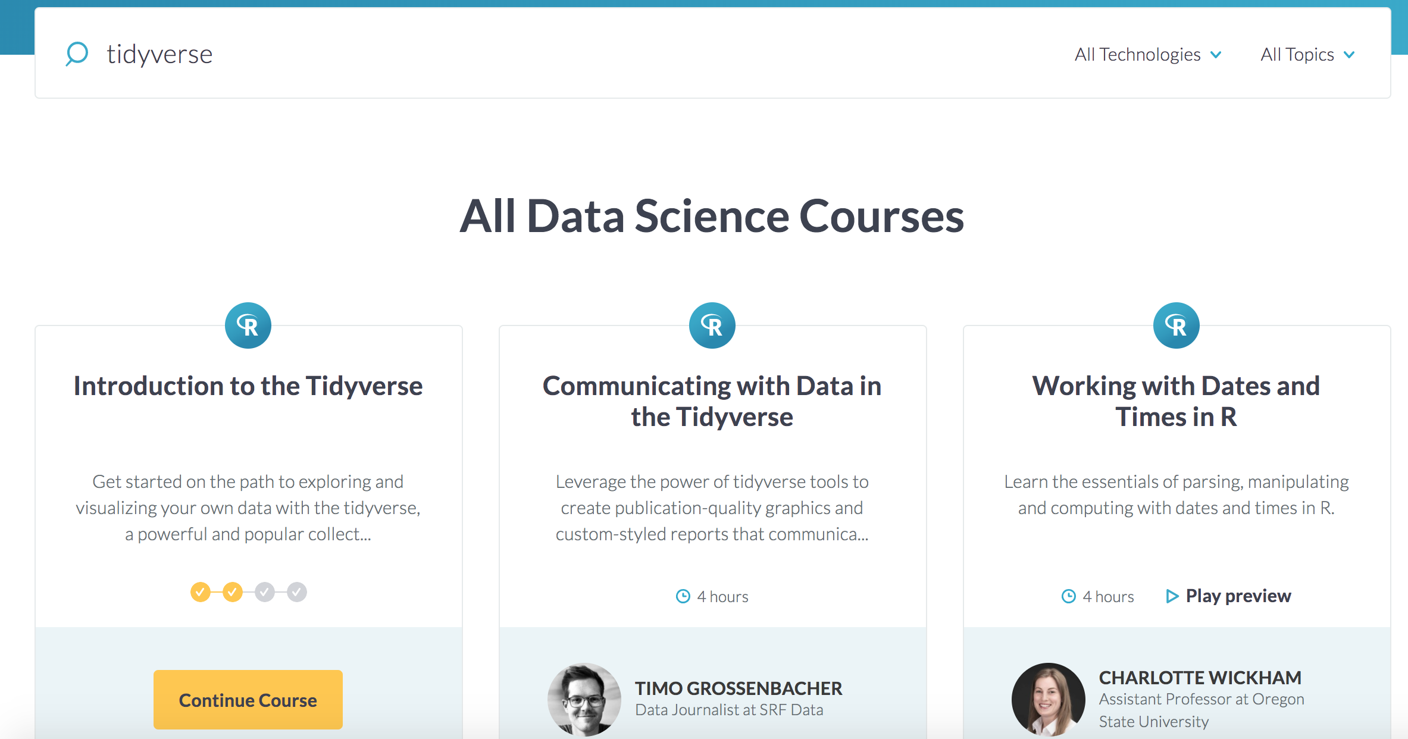
DataCamp.com

Slide 26

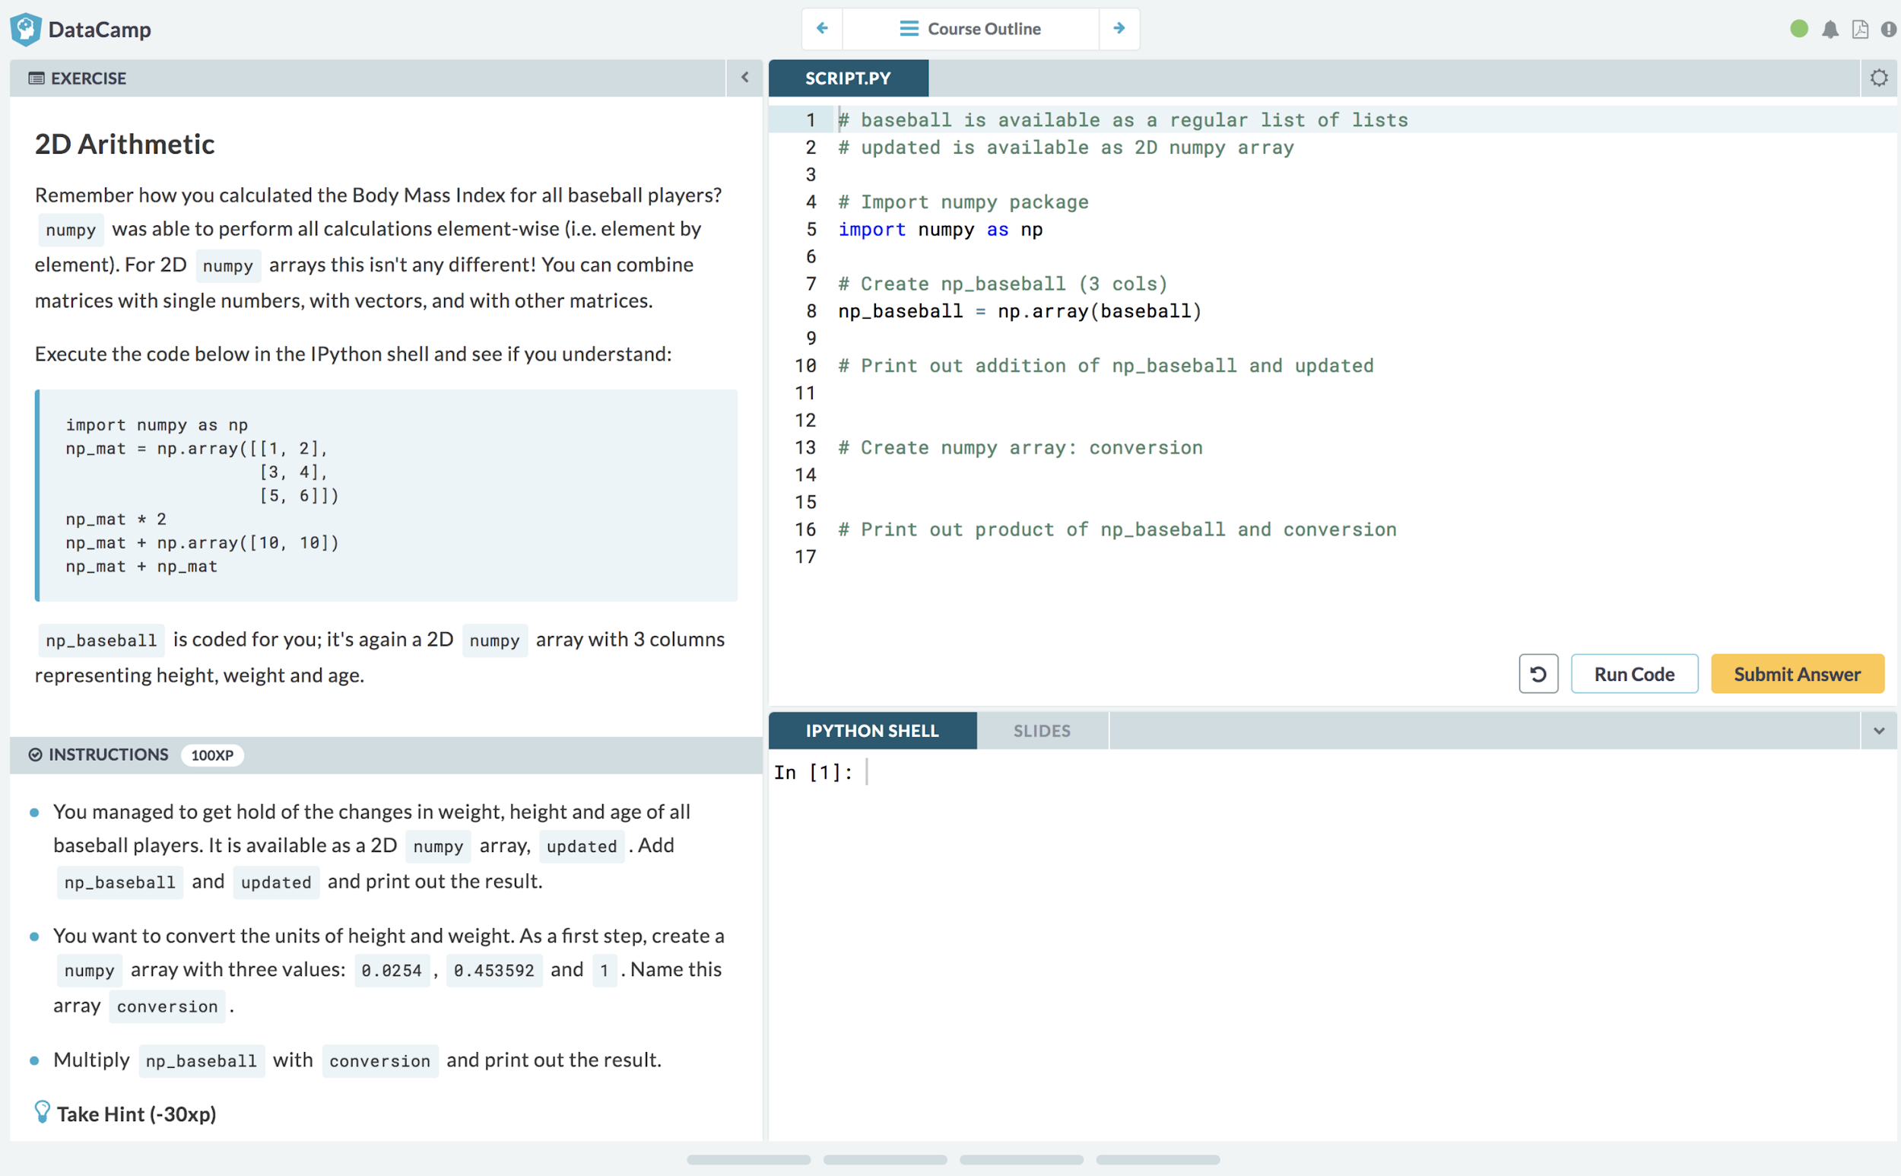
Learn | https://datacamp.com/courses
Notes:
Step 1: Learning takes place in an interactive environment that exposes a real python session to the student

Slide 27
And more!
https://tidyverse.org
https://rstudio.com/resources/cheatsheets
http://tiny.cc/hadleyvid

Slide 28

Conclusion

Slide 29
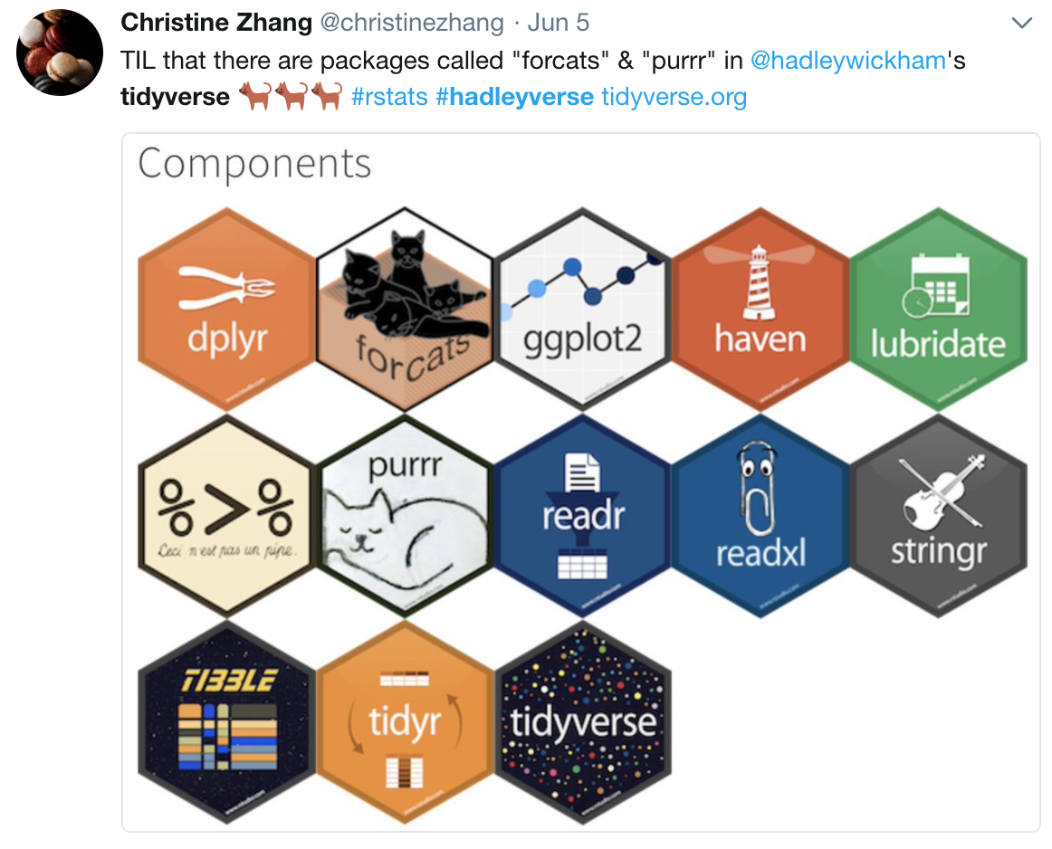
The tidyverse
Come for the stickers and package names …
Stay for the friendly community and happy workflow

Slide 30





Thank you!
tiny.cc/wiatalk
hookedondata.org
@robinson_es

